Slide 1
Web Application Architecture, HTTP protocol
By Iryna Bzdyr

Slide 2
What is Web application architecture?
Web application architecture is a mechanism that determines how application components communicate with each other. Or, in other words, the way the client and the server are connected is established by web application architecture.
Web applications of different sizes and complexity levels all follow the same architectural principle, but details may differ. We will further explain how a basic request-response process works and what components comprise the architecture.
Client - Server Model:
In client-server architecture the machine that requests for some data or the machine that consumes the data is called as a Client and the machine the accepts the client's requests and provides the required data as response is called as a Server. The client and server connected with each other with Internet (world wide web), and they uses common medium and common language to communicate with each other. The medium they use is HTTP Protocol and the language use JSON or XML data formats. Which means the client will be sending HTTP Request to server in JSON or XML format, server understands the request and sends HTTP Response in JSON or XML format.

Slide 3
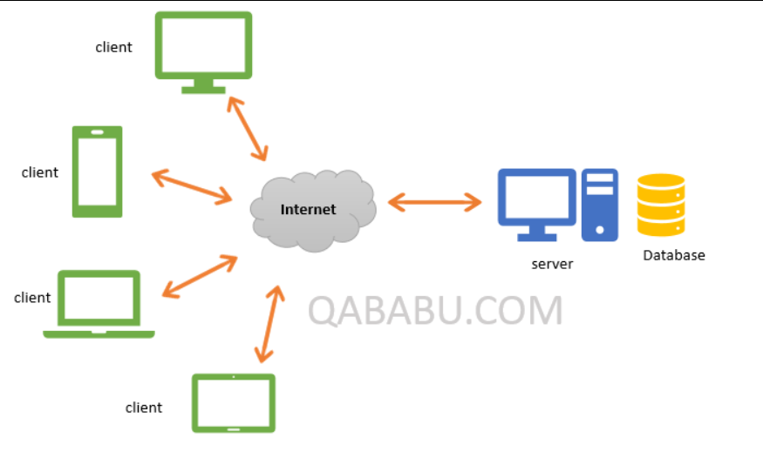

Slide 4
The moment you enter URL address in your browser and you hit ENTER, a lot of different things happen:
The URL gets resolved
A Request is sent to the server of the website
The response of the server is parsed
The page is rendered and displayed

Slide 5
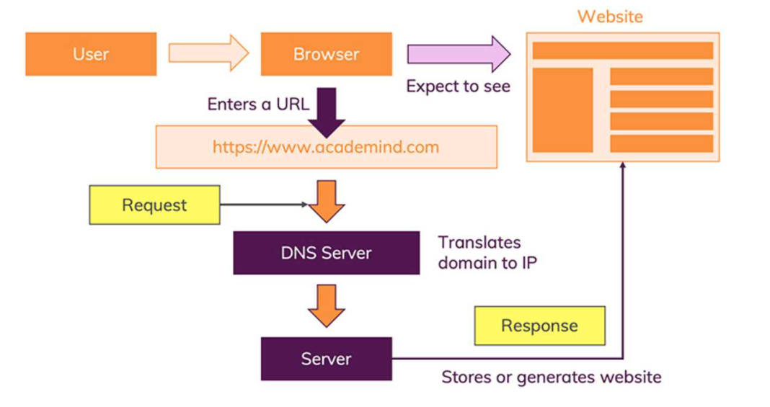

Slide 6

Step 1 - URL Gets Resolved
First, you visit amazon.com. You type in the URL and as you hit Enter, your browser prepares to recognize this URL, because it needs to know the address of the server where the page is located.
You enter amazon.com (that is called “a domain”) but actually, the server which hosts the source code of a website, is identified via IP (= Internet Protocol) addresses. The browser sends a “request” (see step 2) to the server with the IP address you entered (indirectly - you of course entered amazon.com).
So it sends your request to the Domain Name Center (DNS), a repository of domain names and their IP addresses. If you’ve already visited Amazon from the same browser, it will pull the address from the cache.

Slide 7
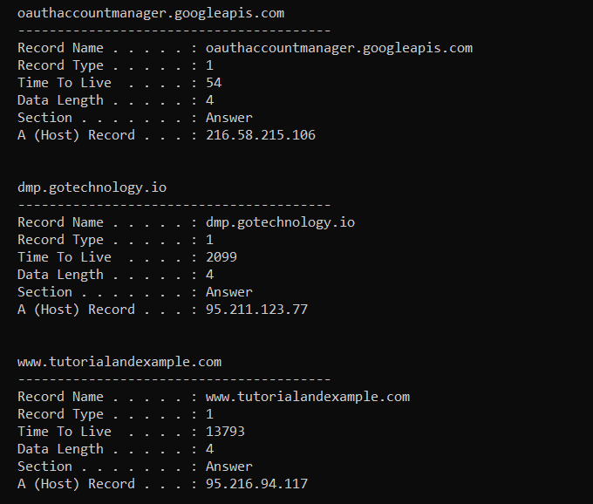
IP address from the cache
Command prompt ipconfig /displaydns

Slide 8
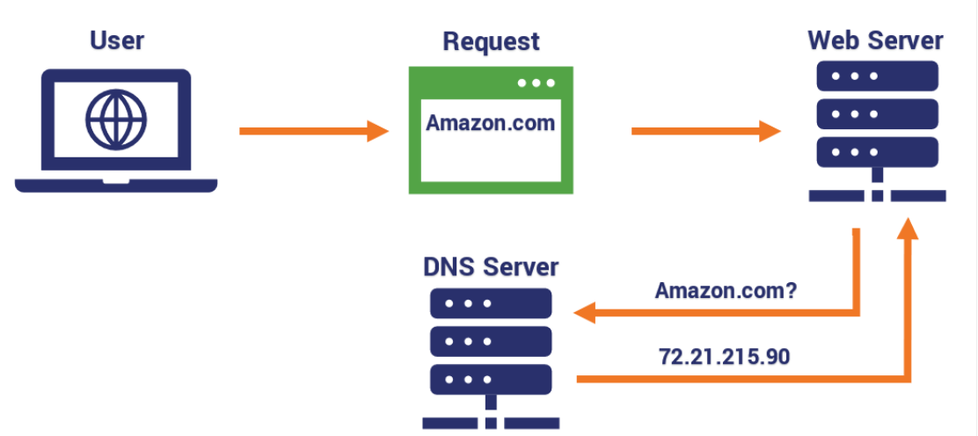
The Domain Name System (DNS) is the phonebook of the Internet. When users type domain names such as ‘google.com’ or ‘nytimes.com’ into web browsers, DNS is responsible for finding the correct IP address for those sites. Browsers then use those addresses to communicate with origin servers or CDN edge servers to access website information. This all happens thanks to DNS servers: machines dedicated to answering DNS queries.
Текст слайда

Slide 9
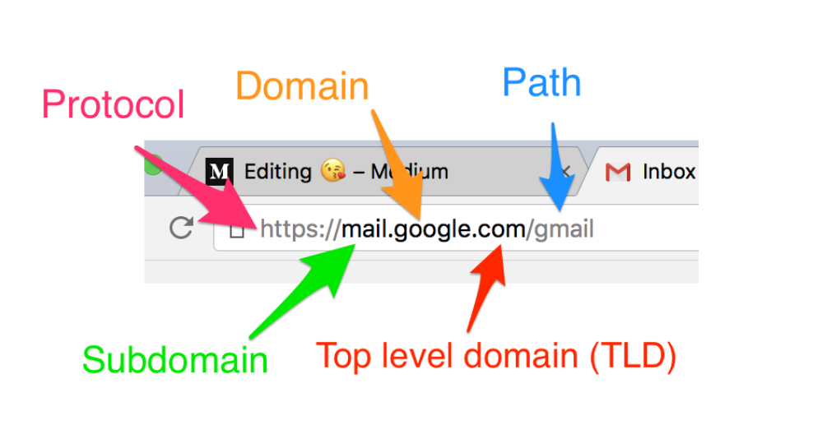

Slide 10
Anatomy of a URL
Protocol:
In general terms, a protocol is a set of standards or rules all parties have agree upon to use in practice. In terms of the internet, a network protocol is a set of standards that determines how two computers communicate with each other over a network.
Domain name (second level domain)
A domain name is your website name. In the example above, ‘google’ is the address where internet users can access your website.
Subdomain
A subdomain is a sub-division of a domain name. The subdomain always comes before the domain name. With most URLs, the subdomain in www.google.com is ‘www’, but in the example above, ‘mail’ is the subdomain for the domain ‘google’.
Top Level Domain
In our example above ‘com’ is the top level domain. Top level domains are at the highest level in the hierarchical Domain Name System of the Internet. The most common TLDs are .com, .net and .org.
Path
The path refers to the file or directory on the web server. When you incorrectly type in a URL with the wrong Path, you either get a HTTP status code of 404 Resource Not Found or 301 Moved Permanently.

Slide 11
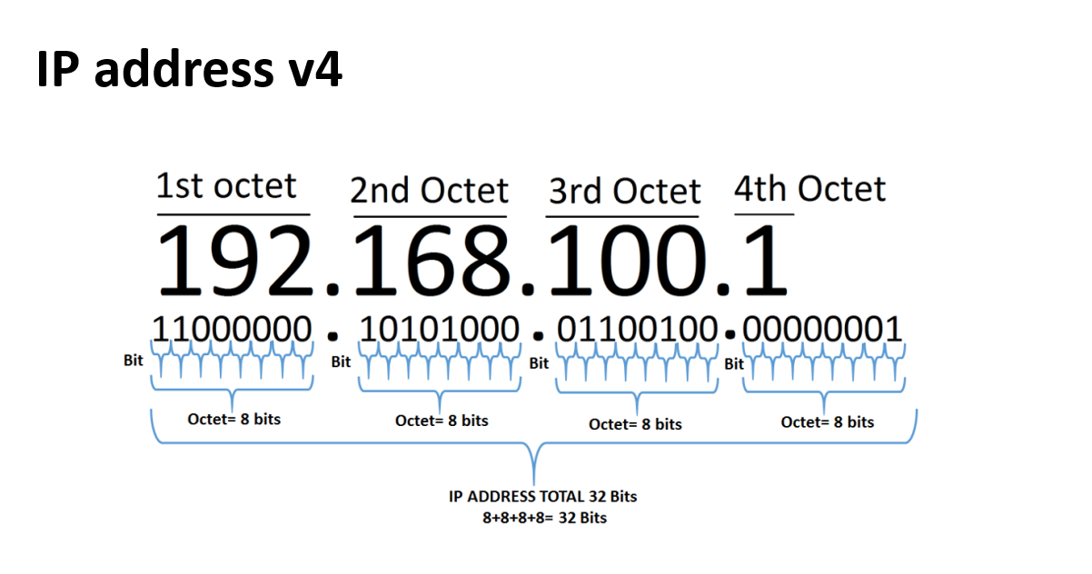

Slide 12
Step 2 - Request Is Sent
With the IP address resolved, the browser goes ahead and makes a request to the server with that IP address.
“A request” is not just a term. It really is a technical thing that happens behind the scenes.
The browser bundles up a bunch of information (What’s the exact URL? Which kind of request should be made? Should metadata be attached) and sends that data package to the IP address.
The data is sent via the “HyperText Transfer Protocol” (known as “HTTP”) - a standardized protocol which defines what a request (and response) has to look like, which data may be included (and in which form) and how the request will be submitted.

Slide 13
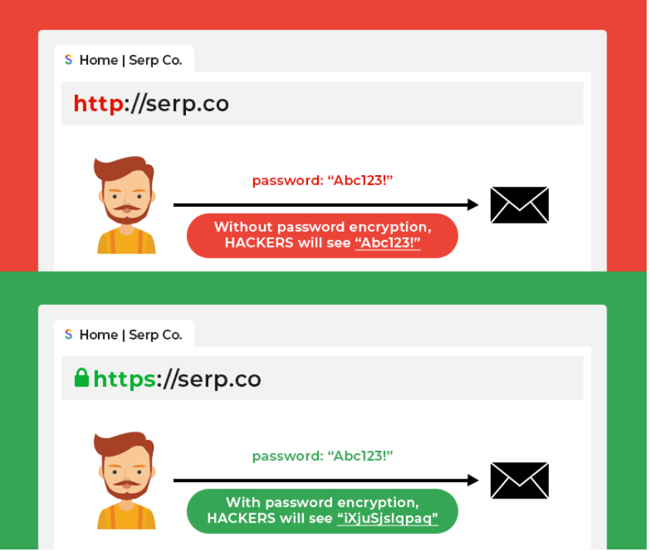
HTTP stands for Hypertext Transfer Protocol. This is the protocol used to data to a browser from a server. This is the most basic form that allows users to view web pages. Early websites used this protocol back in the days.
The main issue that sets HTTP apart form HTTPS is the fact that the flow of information can be stolen since it is not encrypted. Through the use of an SSL (secure sockets layer) certificate, HTTPS solves this by creating an encrypted connection between server and browser. In this way, any sensitive information being shared by the server and browser is protected and cannot be easily stolen.

Slide 14
BASIS FOR COMPARISON | HTTP | HTTPS
Prefix Used | Url begins with "http://" | Url begins with "https://"
Security | Unsecured. | Secured.
Operated On | Application layer | Transport layer.
Encryption | No encryption is there | Encryption is used.
Certificate | Not required. | Necessary
Port Used | Port number 80 is used for communication. | Port number 443 is used for communication.
Characteristics | It is subject to man-in-the-middle and eavesdropping attacks. | It is designed to resist man-in-the-middle and eavesdropping attacks and is considered secure against such attacks.
Example | Websites like internet forums, educational sites. | Websites like Banking Websites, Payment gateway, Shopping Websites, etc.

Slide 15
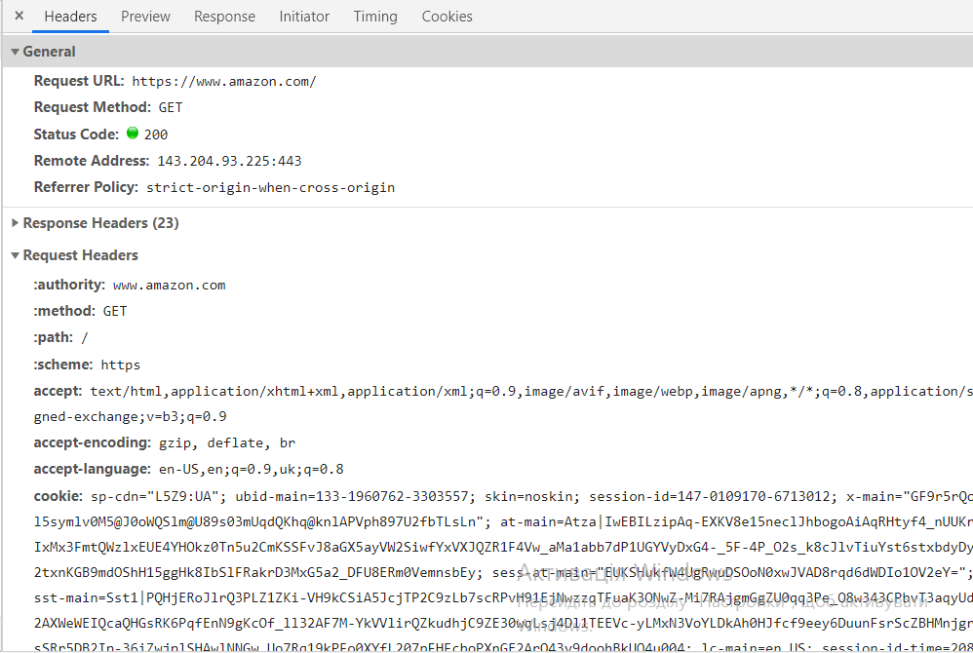

Slide 16
.N. | Method and Description
1 | GET The GET method is used to retrieve information from the given server using a given URI. Requests using GET should only retrieve data and should have no other effect on the data.
2 | HEAD Same as GET, but transfers the status line and header section only.
3 | POST A POST request is used to send data to the server, for example, customer information, file upload, etc. using HTML forms.
4 | PUT Replaces all current representations of the target resource with the uploaded content.
5 | DELETE Removes all current representations of the target resource given by a URI.
6 | CONNECTE stablishes a tunnel to the server identified by a given URI.
7 | OPTIONS Describes the communication options for the target resource.
8 | TRACE Performs a message loop-back test along the path to the target resource.

Slide 17
S.N. | Code and Description
1 | 1xx: InformationalIt means the request has been received and the process is continuing.
2 | 2xx: SuccessIt means the action was successfully received, understood, and accepted.
3 | 3xx: RedirectionIt means further action must be taken in order to complete the request.
4 | 4xx: Client ErrorIt means the request contains incorrect syntax or cannot be fulfilled.
5 | 5xx: Server ErrorIt means the server failed to fulfill an apparently valid request.

Slide 18
Step 3 - Response Is Parsed
The browser receives the response sent by the server. This alone, doesn’t display anything on the screen though.
Instead, the next step is that the browser parses the response. Just as the server did it with the request. Again, the standardization enforced by HTTP helps of course.
The browser checks the data and metadata that’s enclosed in the response. And based on that, it decides what to do.
You might’ve had cases where a PDF opened in your browser. That happened because the response informed the browser that the data is not a website but a PDF document instead. And the browser tries to pick the best handling mechanism for any data type it detects.
Back to our website scenario.
In that case, the response would contain a specific piece of metadata, that tells the browser that the response data is of type text/html.

Slide 19
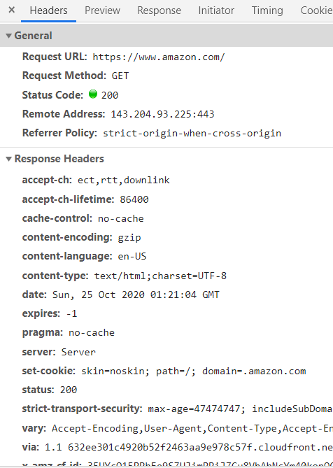
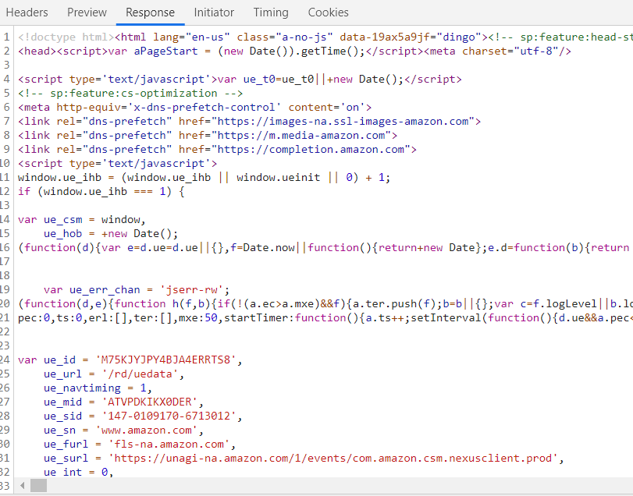

Slide 20
Step 4 - Page Is Displayed
As mentioned, the browser goes through the HTML data returned by the server and builds a website based on that.
Though it is important to know, that HTML does not include any instructions regarding what the site should look like (i.e. how it should be styled). It really only defines the structure and tells the browser which content is a heading, which content is an image, which content is a paragraph etc. This is especially important for accessibility - screen readers get all the useful information out of the HTML structure.

Slide 21
Server-side vs Browser-side
From the four steps above, you learned that we can differentiate two core “sides” when talking about the web: Server-side and Browser-side (or: Client-side since we can also access the internet without a browser - see below!).
If you’re interested in becoming a web developer, it’s important to know that you use different technologies and programming languages for these sides.
Server-side
You need server-side programming languages - i.e. languages that don’t work in the browser but that can run on a normal computer (a server is in the end just a normal computer).
Examples would be:
Node.js
PHP
Python
Browser-side
In the browser, there are exactly three languages/ technologies you need to learn. But whilst the server-side languages were alternatives, these three browser-side languages are all mandatory to know and understand:
HTML (for the structure)
CSS (for the styling)
JavaScript (for dynamic content)

Slide 22
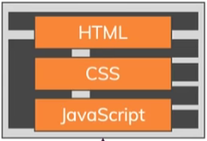
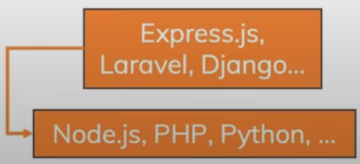

Slide 23
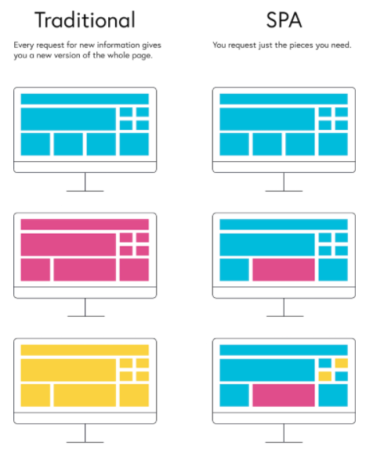
Multiple-page applications work in a “traditional” way. Every change eg. display the data or submit data back to server requests rendering a new page from the server in the browser. These applications are large, bigger than SPAs because they need to be. Due to the amount of content, these applications have many levels of UI. Luckily, it’s not a problem anymore. Thanks to AJAX, we don’t have to worry that big and complex applications have to transfer a lot of data between server and browser. That solution improves and it allows to refresh only particular parts of the application. On the other hand, it adds more complexity and it is more difficult to develop than a single-page application.
A single-page application is an app that works inside a browser and does not require page reloading during use. You are using this type of applications every day. These are, for instance: Gmail, Google Maps, Facebook or GitHub. SPAs are all about serving an outstanding UX by trying to imitate a “natural” environment in the browser — no page reloads, no extra wait time. It is just one web page that you visit which then loads all other content using JavaScript — which they heavily depend on.

Slide 24
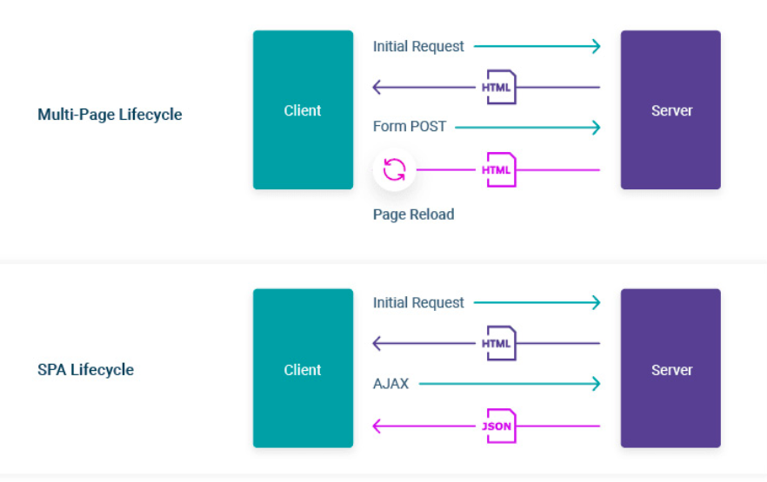

Slide 27
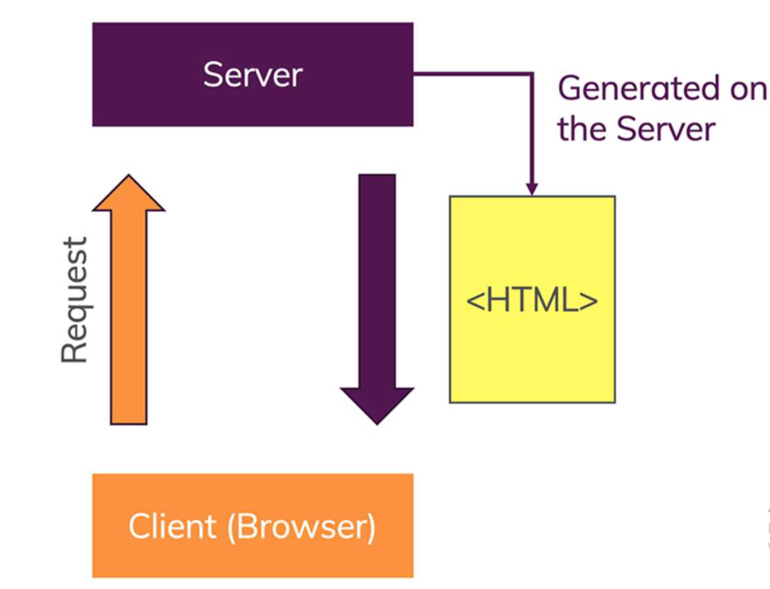
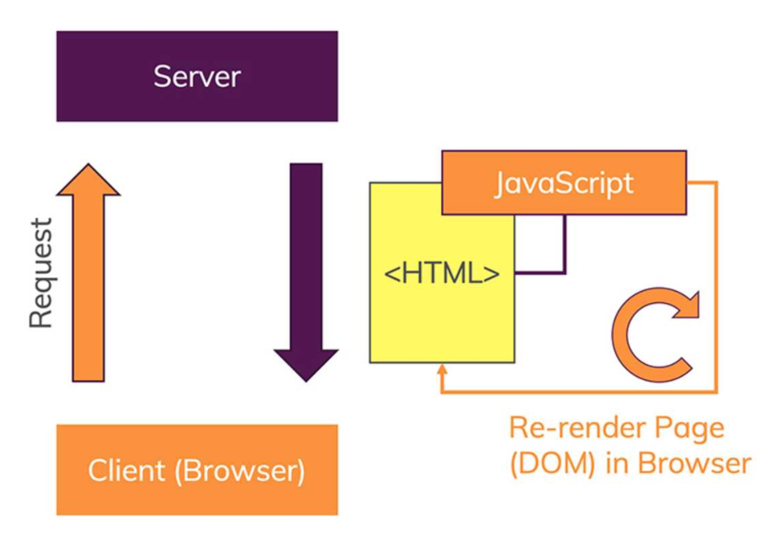

Slide 28


